Slide 1
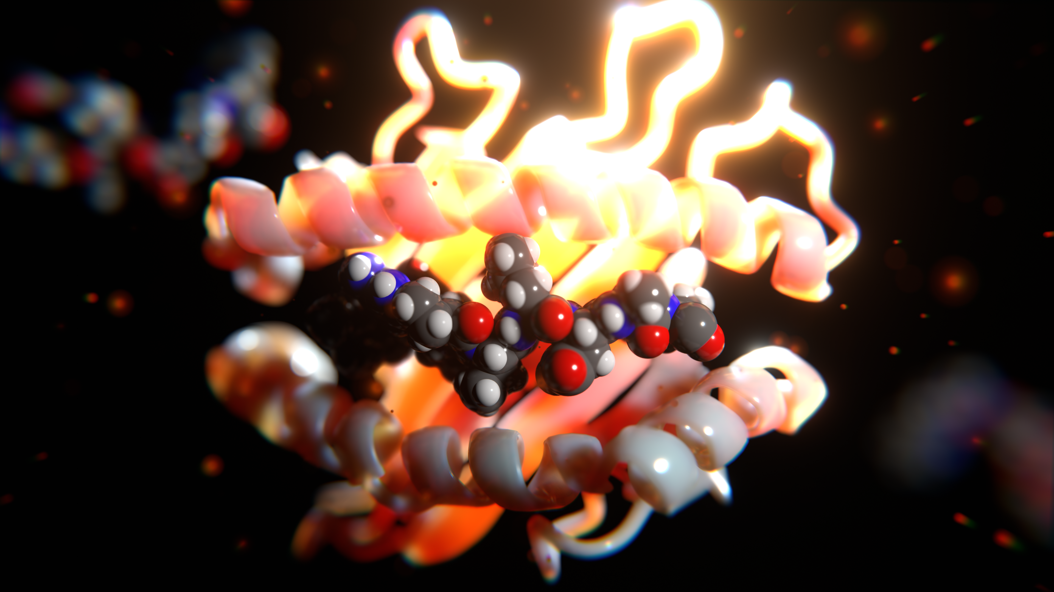
20.S947: 3D Scientific Rendering
David W. Kastner | MIT IAP COURSE Jan 18-25, 2023

Slide 2
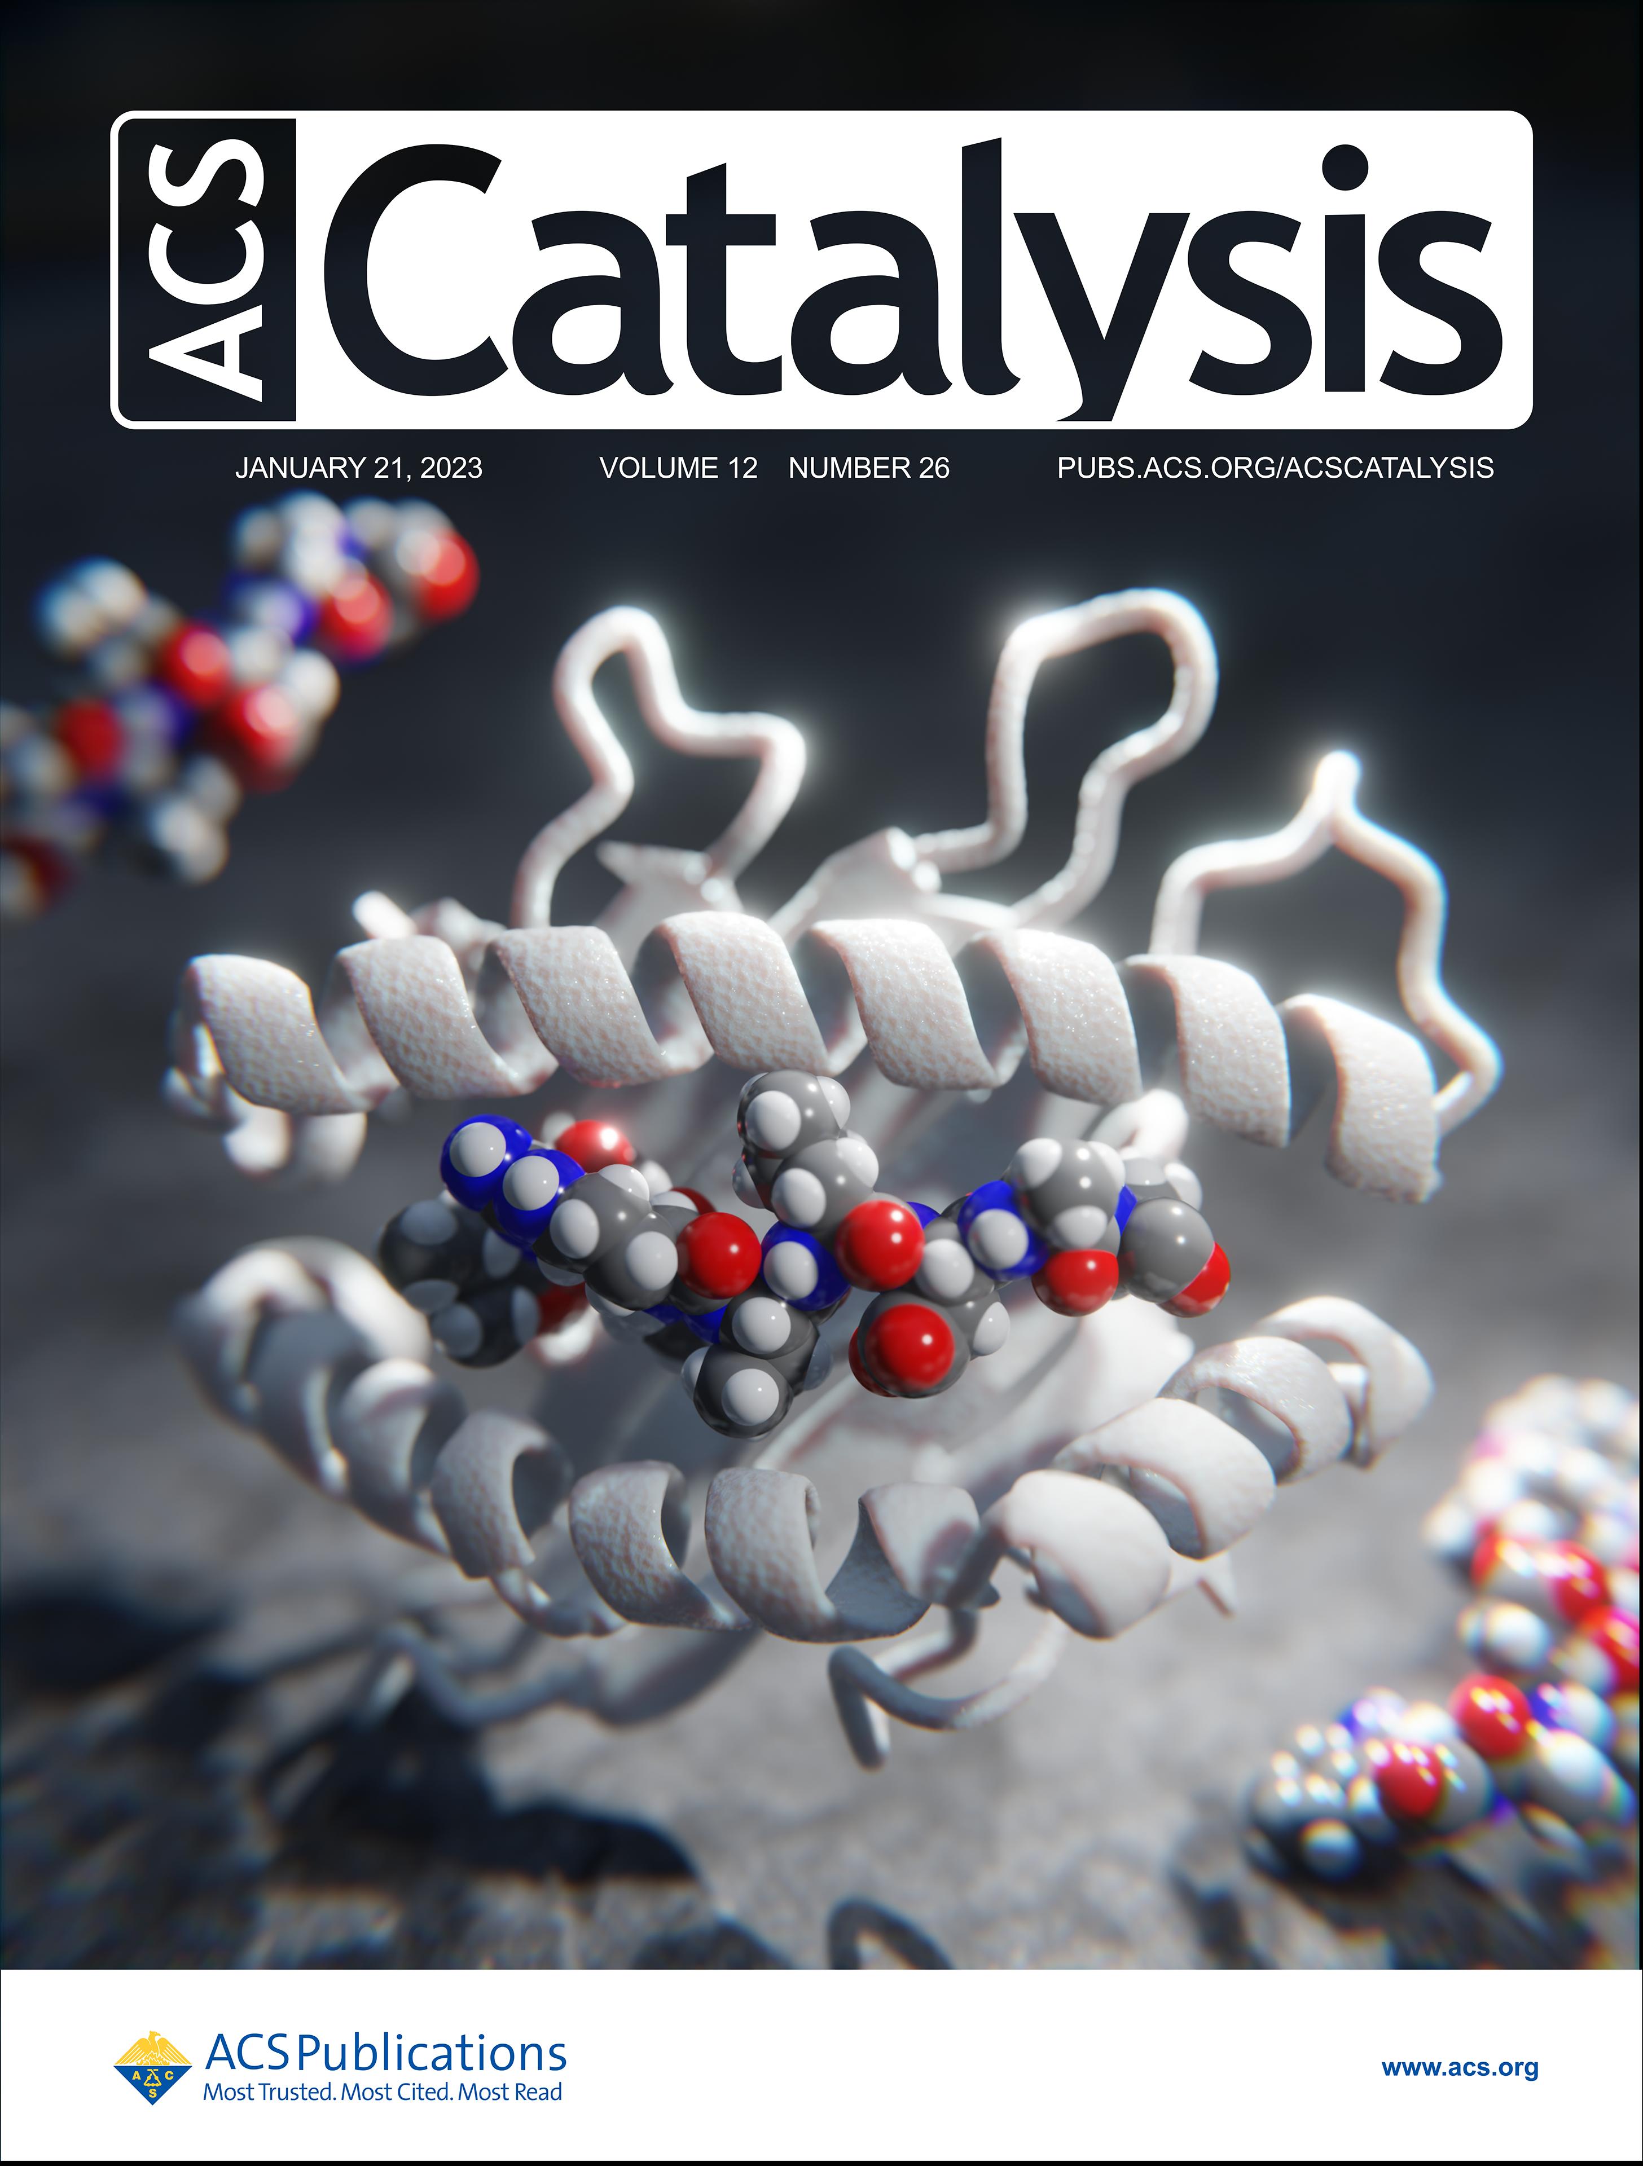
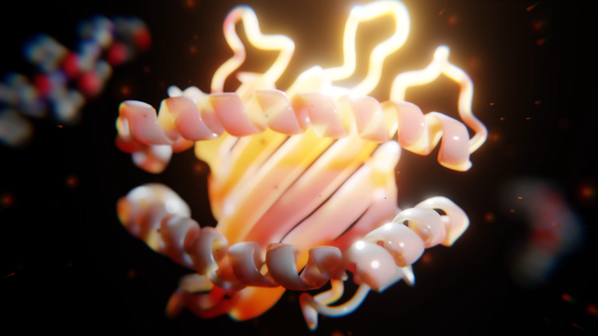
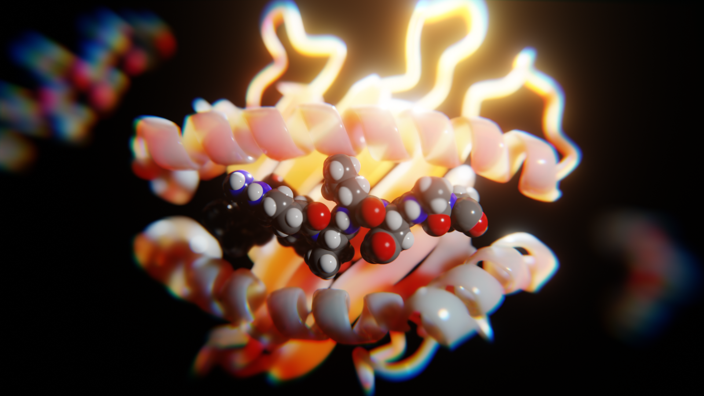
From Beginner to Advanced: A Three-Part Course
Lesson 1: The 3D Viewport and Lighting
Converting molecular structures to 3D meshes
Basics of manipulating molecular structures in Blender
Experimenting with Blender materials for molecules
Experimenting with lighting for molecular scenes
More realistic Eevee render settings
Stylize your molecular scene with the compositor
Lesson 2: Designing a Journal Cover
Viewing your molecular scene from the lens of a journal cover
Using environmental textures to improve molecular scenes
Adding procedural material to molecules
Adding realistic PBR material to molecules
Create a dust and smudged lens effect with compositor
Lesson 3: Scientific Animations and Movies
Animating a ligand binding
Creating a looping animation effect
Creating predictable dust particles that appear random
Rendering and processing an animation in Blender

Slide 3
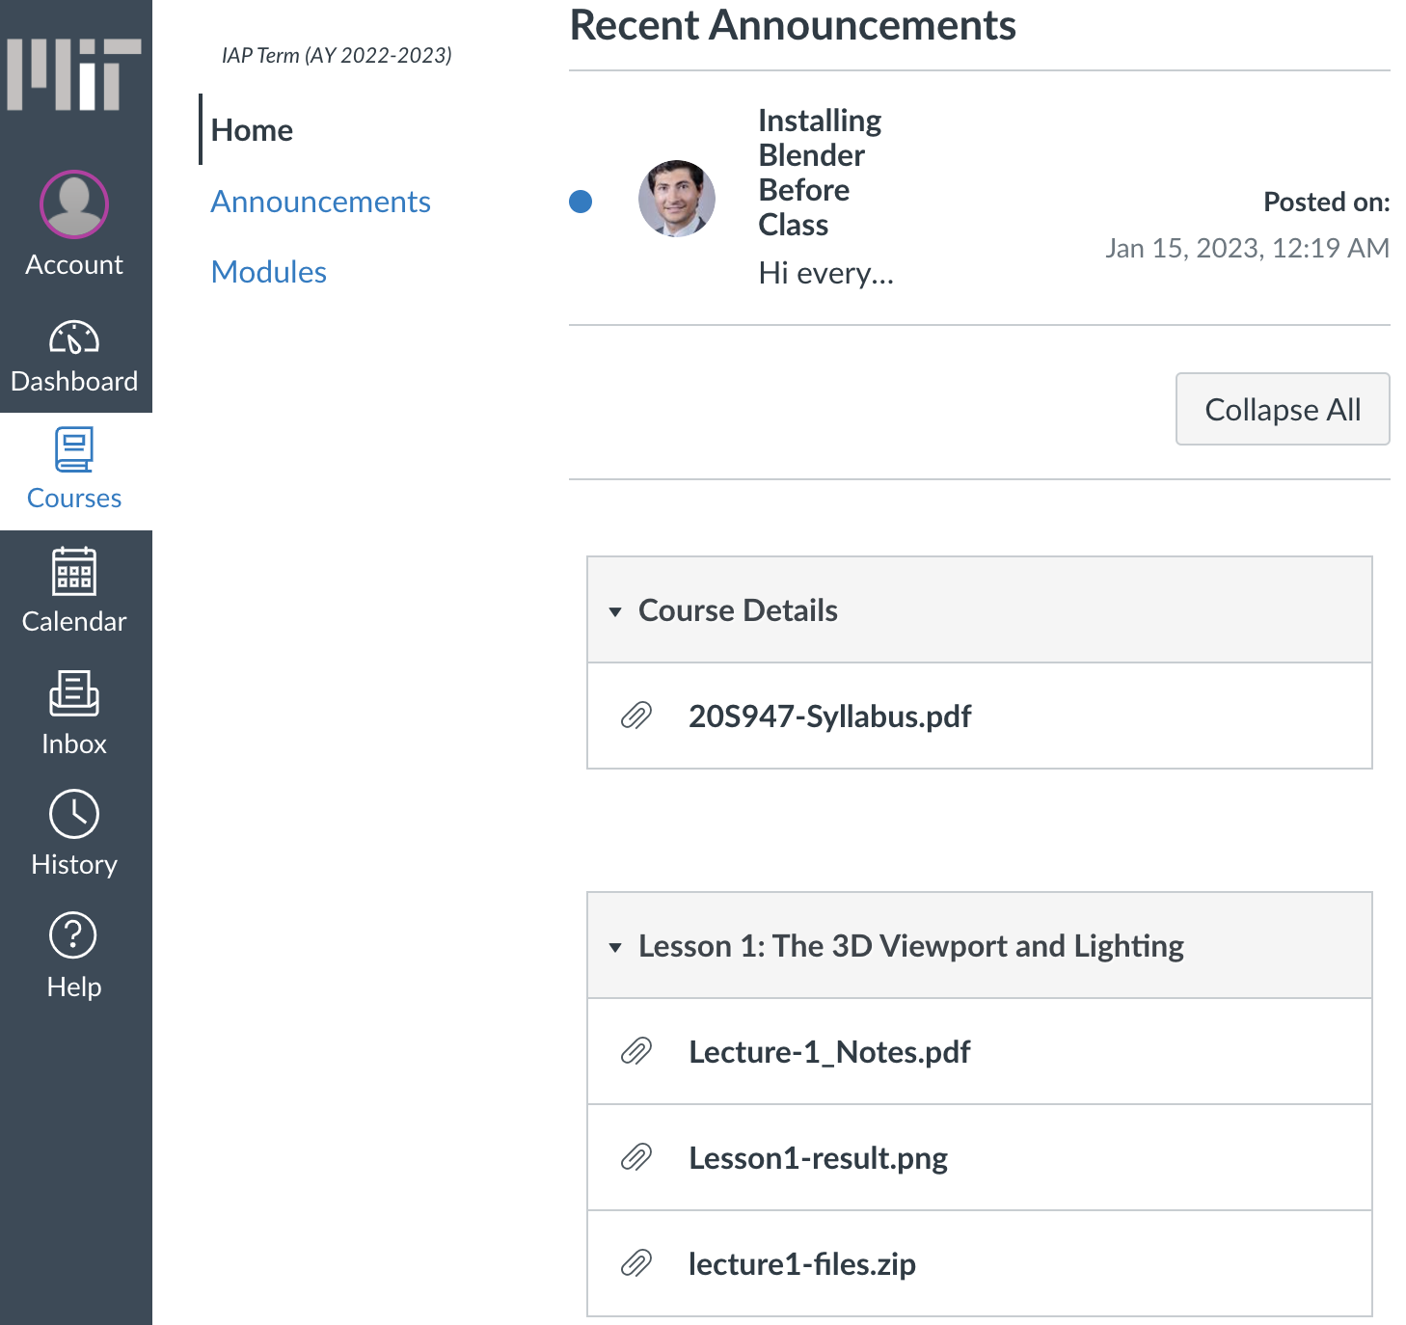
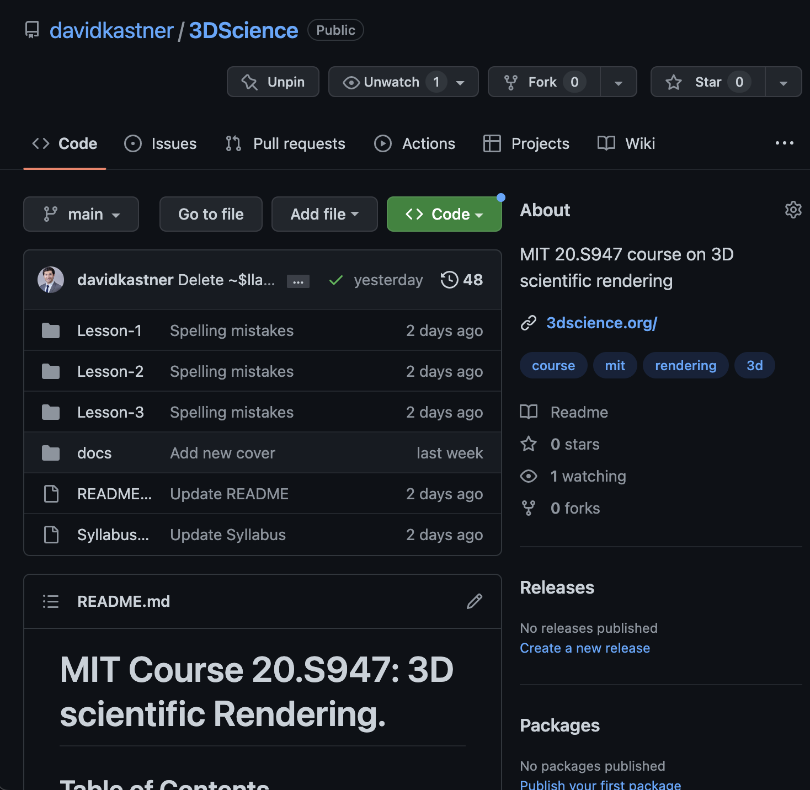
Course Documents and Following Along

